Slide 1


POWHATAN COUNTY WATER AND WASTEWATER SYSTEM
2024 Consumer Confidence Report
Powhatan County Public Works Department is pleased to present its annual Consumer Confidence Report as required by the Safe Drinking Water Act (SDWA). This report is designed to provide details about where your water comes from, what it contains, and how it compares to standards set by the regulatory agencies. This report covers all testing completed from January 1 through December 31, 2023. We are committed to providing you with information because informed customers are our best allies.
Source Water Assessment and Availability
The source of water for the Powhatan County water system (Flat Rock system) is the James River. Water is drawn out of the river by the City of Richmond’s Department of Public Works, from there, it is treated and sold to Chesterfield County who sells the water to Powhatan County. Powhatan has a contract with Chesterfield County to purchase up to 0.572 million gallons per day (MGD). In 2024, Powhatan County’s average daily usage was 0.163 MGD.
For information or questions please contact; Tim Glidewell
2322 Skaggs Road Powhatan, VA 23139
(804) 598-5764

Slide 2
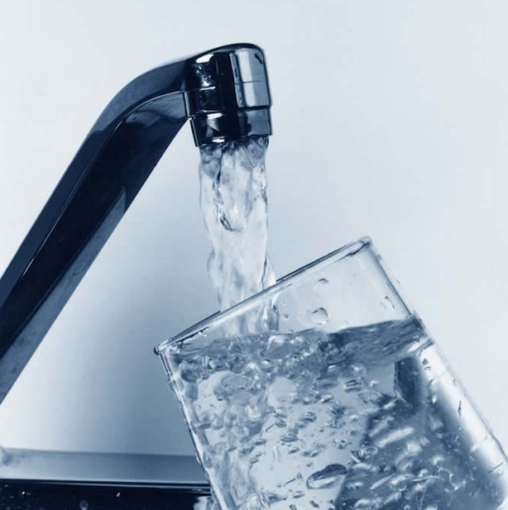
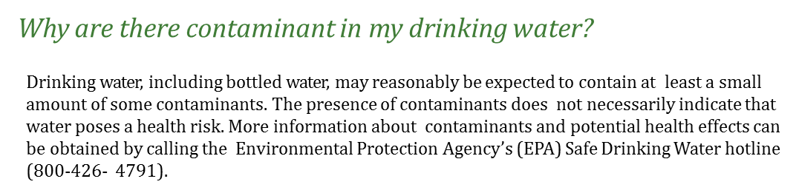
CROSS CONNECTION CONTROL
A cross connection is an unprotected or improper connection to a public water distribution system that may cause contamination or pollution to enter the system. We are responsible for enforcing cross-connection control regulations and insuring that no contaminants can, under any flow conditions, enter the distribution system. If you have any of the devices listed below please contact us so that we can discuss the issue, and if needed, survey your connection and assist you in isolating it if necessary;
Boiler/Radiant heater (water heaters not included)
Underground lawn sprinkler system
Pool or hot tub
Additional source(s) of water on the property
Decorative pond
Watering trough
SOURCES AND CONTAMINANTS
Sources of drinking water (both tap water and bottled water) include rivers, lakes, streams, ponds, reservoirs, springs, and wells. As water travels over the surface of the land or through the ground, it dissolves naturally occurring minerals (such as iron), and in some cases can dissolve radioactive material. Water can also pick up contaminants from the presence of animals or human activity.
Types of contaminants that may be present in drinking water sources include;
Microbial Contaminants, such as viruses and bacteria from sewage treatment plants, septic systems, agricultural operations and wildlife
Inorganic contaminants, such as salts
and metals (both naturally occurring and from surface runoff, industrial, oil and gas, mining, or farming
Herbicides/pesticides, which may come from a variety of sources such as, agricultural, urban runoff or residential uses.
Organic contaminants, including synthetic and volatile organic chemicals, which are by- products of industrial and petroleum processes and can also come from gas stations, urban storm water runoff and septic systems.
Radioactive contaminants, which can be naturally occurring or be the result of oil and gas production and mining activities.

Slide 3
RESULTS OF CRYPTOSPORIDIUM MONITORING
Cryptosporidium is a microbial pathogen found in surface water throughout the United States. Although filtration can remove some cryptosporidium, most commonly used filtration methods cannot guarantee 100 percent removal. Our monitoring indicates the presence of these organisms in our source and/or finished water. Current test methods do not allow us to determine if the organisms are dead or if they are capable of causing disease. Ingestion of cryptosporidium may cause cryptosporidiosis, an abdominal infection. Symptoms of infection include nausea, diarrhea, and abdominal cramps. Most healthy individuals can overcome the disease within a few weeks. However. Immunocompromised people are at a greater risk of developing life-threatening illness. We encourage immunocompromised individuals to consult their doctor regarding appropriate precautions to take to avoid infection. Cryptosporidium must be ingested to cause disease, and it may be spread through means other than drinking water. The City of Richmond collected samples between 2015 and 2018 and found an average of 5.4 Oocysts/100L. This is less than the Action Level of 7.5 Oocysts/100L
DESCRIPTION OF THE TREATMENT PROCESS
Your water is treated by filtration and disinfection. Filtration removes particles suspended in the source water. Particles typically include clays and silts, natural organic matter, iron and manganese, and microorganisms. Your water is also treated by disinfection. Disinfection involves the addition of chlorine or other disinfectants to kill bacteria and other microorganisms (viruses, cysts, etc.) that may be in the water. Disinfection is considered to be one of the major public health advances of the 20th century.
LEAD IN DRINKING WATER
Lead can cause serious health problems, especially for pregnant women and young children. Lead in drinking water is primarily from materials and components associated with service lines and home plumbing. Powhatan County Utilities is responsible for providing high quality drinking water and removing lead pipes, but cannot control the variety of materials used in plumbing components in your home. You share the responsibility for protecting yourself and your family from the lead in your home plumbing. You can take responsibility by identifying and removing lead materials within your home plumbing and taking steps to reduce your family's risk. Before drinking tap water, flush your pipes for several minutes by running your tap, taking a shower, doing laundry or a load of dishes. You can also use a filter certified by an American National Standards Institute accredited certifier to reduce lead in drinking water. If you are concerned about lead in your water and wish to have your water tested, contact Powhatan County Utilities at (804) 598-5764. Information on lead in drinking water, testing methods, and steps you can take to minimize exposure is available at http://www.epa.gov/safewater/lead.
To address lead in drinking water, public water systems were required to develop and maintain an inventory of service line materials by October 16,2024. Developing an inventory and identifying the location of lead service lines. The lead service inventory can be accessed at Flat Rock Area Water System LCRR
DO I NEED TO TAKE PRECAUTIONS?
Some people may be more vulnerable than the general population to contaminants in drinking water. Immunocompromised persons such as persons with cancer undergoing chemotherapy, persons who have undergone organ transplants, people with HIV/AIDS or other immune system disorders, some elderly, and infants can be particularly at risk from infections. These people should seek advice about drinking water from their health care providers.
EPA/Centers for Disease Control (CDC) guidelines on appropriate means to lessen the risk of infection by Cryptosporidium and other microbial contaminants are available from the Safe Drinking Water Hotline (800-426-4791).

Slide 4

Water Quality Data Table
In order to ensure that tap water is safe to drink, EPA prescribes regulations which limit the amount of contaminants in water provided by public water systems. The table below lists all of the drinking water contaminants that we detected during the calendar year of this report. Although many more contaminants were tested, only those substances listed below were found in your water. All sources of drinking water contain some naturally occurring contaminants. At low levels, these substances are generally not harmful in our drinking water. Removing all contaminants would be extremely expensive, and in most cases, would not provide increased protection of public health. A few naturally occurring minerals may actually improve the taste of drinking water and have nutritional value at low levels. Unless otherwise noted, the data presented in this table is from testing done in the calendar year of the report. The EPA or the State requires us to monitor for certain contaminants less than once per year because the concentrations of these contaminants do not vary significantly from year to year, or the system is not considered vulnerable to this type of contamination. As such, some of our data, though representative, may be more than one year old. In this table you will find terms and abbreviations that might not be familiar to you. To help you better understand these terms, we have provided the definitions after the table.
The following unregulated substances are monitored in your water.
Contaminants | MCLG or MRDLG | MCL, TT, or MRDL | Your Water | Violation | Typical Source
Bromodichloromethane (ppb) |  |  | 5.2 | NA | Byproduct of drinking-water disinfection
Chlorodibromomethane (ppb) |  |  | 0.68 | NA | Byproduct of drinking-water disinfection
Chloroform (ppb) |  |  | 29.8 | NA | Byproduct of drinking-water disinfection
Sulfate (ppm) |  |  | 43.3 | NA | Water additive to remove particles

Slide 5
Contaminants | MCLG or MRDLG | MCL, TT, or MRDL | Your Water | Range |  | Sample Date | Violation | Typical Source
 |  |  |  | Low | High
Regulated Substances
(There is convincing evidence that addition of a disinfectant is necessary for control of microbial contaminants)
Alpha Emitters (pCi/L) | 0 | 15 | ND | NA | NA | 2019 | No | Erosion of natural deposits
Nitrate (ppm) | 10 | 10 | 0.08 | NA | NA | 2024 | No | Runoff from fertilizer use; leaching from septic tanks, sewage, erosion of natural deposits
Haloacetic Acids (HAA5) (ppb) | NA | 39 | 30.5 | 4.3 | 39.0 | 2024 | No | By-product of drinking water chlorination
TTHMs [Total Trihalomethane] (ppb) | NA | 46 | 31.0 | 15 | 50 | 2024 | No | By-product of drinking water disinfection
Total Organic Carbon (% Removal) | NA | TT | 1.37 | 0.6 | 1.7 | 2024 | No | Naturally present in the environment
Barium (ppm) | 2 | 2 | 0.027 | NA | NA | 2024 | No | Discharge of drilling wastes; discharge from metal refineries; erosion of natural deposits
Beta/Photon Emitters (pCi/L) | 0 | 50 | 1.6 | NA | NA | 2019 | No | Decay of natural and human-made products
Chloramines ( ppm) | [4] | [4] | 2.48 | 0.01 | 4.4 | 2024 | No | Water additive used to control microbes
Chlorite (ppm) | 0.8 | 1 | 0.47 | NA | 0.47 | 2024 | No | By product of drinking water disinfection
Combined Radium (pCi/L) | 0 | 5 | ND | NA | NA | 2019 | No | Erosion of Natural Deposits
Fluoride (ppm) | 4 | 4 | 0.97 | 0.2 | 0.97 | 2024 | No | Erosion of natural deposits; water additive which promotes strong teeth; discharge from fertilizer and aluminum factories
Turbidity (NTU) | NA | TT | 0.31 | 0.01 | 0.31 | 2024 | No | Soil runoff
Turbidity (lowest monthly percent of samples meeting limit) | NA | TT = 95% of samples meet the limit | 100 | NA | NA | 2024 | No | Soil runoff
Total Coliform Bacteria (% positive samples) | NA | TT | 0 | NA | NA | 2024 | No | Naturally present in the environment

Slide 6
Lead and Copper
Contaminants | MCLG | AL | Your Water | Sample Date | # Samples Exceeding AL | Exceeds AL | Typical Source
Inorganic Contaminants
Copper - action level at consumer taps (ppm) | 1.3 | 1.3 | 0.100 | 2023 | 0 | No | Corrosion of household plumbing systems; Erosion of natural deposits
Inorganic Contaminants
Lead - action level at consumer taps (ppb) | 0 | 15 | ND | 2023 | 0 | No | Corrosion of household plumbing systems; Erosion of natural deposits

Slide 7
Unit Descriptions
Term |  | Definition
ppm |  | ppm: parts per million, or milligrams per liter (mg/L)
ppb |  | ppb: parts per billion, or micrograms per liter (µg/L)
mg/L |  | mg/L: Number of milligrams of substance in one liter of water
pCi/L |  | pCi/L: picocuries per liter (a measure of radioactivity)
NTU |  | NTU: Nephelometric Turbidity Units. Turbidity is a measure of the cloudiness of the water. We monitor it because it is a good indicator of the effectiveness of our filtration system.
positive samples/month |  | positive samples/month: Number of samples taken monthly that were found to be positive
NA |  | NA: not applicable
ND |  | ND: Not detected
NR |  | NR: Monitoring not required, but recommended.
Important Drinking Water Definitions
Term | Definition
MCLG | MCLG: Maximum Contaminant Level Goal: The level of a contaminant in drinking water below which there is no known or expected risk to health. MCLGs allow for a margin of safety.
MCL | MCL: Maximum Contaminant Level: The highest level of a contaminant that is allowed in drinking water. MCLs are set as close to the MCLGs as feasible using the best available treatment technology.
TT | TT: Treatment Technique: A required process intended to reduce the level of a contaminant in drinking water.
AL | AL: Action Level: The concentration of a contaminant which, if exceeded, triggers treatment or other requirements which a water system must follow.
Variances and Exemptions | Variances and Exemptions: State or EPA permission not to meet an MCL or a treatment technique under certain conditions.
MRDLG | MRDLG: Maximum residual disinfection level goal. The level of a drinking water disinfectant below which there is no known or expected risk to health. MRDLGs do not reflect the benefits of the use of disinfectants to control microbial contaminants.
MRDL | MRDL: Maximum residual disinfectant level. The highest level of a disinfectant allowed in drinking water. There is convincing evidence that addition of a disinfectant is necessary for control of microbial contaminants.
MNR | MNR: Monitored Not Regulated
MPL | MPL: State Assigned Maximum Permissible Level

